Slide 1
2024 UMANT Strategic Planning Retreat
2pm
The Marq, Southlake

Slide 2
Agenda
Call to meeting (2:10)
Accept minutes of 12/1/2023 Executive Committee Meeting
Expectations for today (2:15-2:20)
What is UMANT? (2:20-2:30)
Introduction of Mark McDaniel, SGR (2:30-2:45)
Year in Review (2:50-3:00)
2024 Introductions (3:00-3:30)
Calendar Discussion (3:30-3:50)
Committee Breakout (3:50-4:20)
Other Items (4:30-5:00)
(2:10)

Slide 3
Expectations for today
Target dates for events in first half of 2024 (target months for second half of 2024)
Meeting the 2024 Executive Committee
Gaining an understanding of your Committee
Reviewing last year and goalsetting for this year
Being inspired
(2:15-2:20)

Slide 4
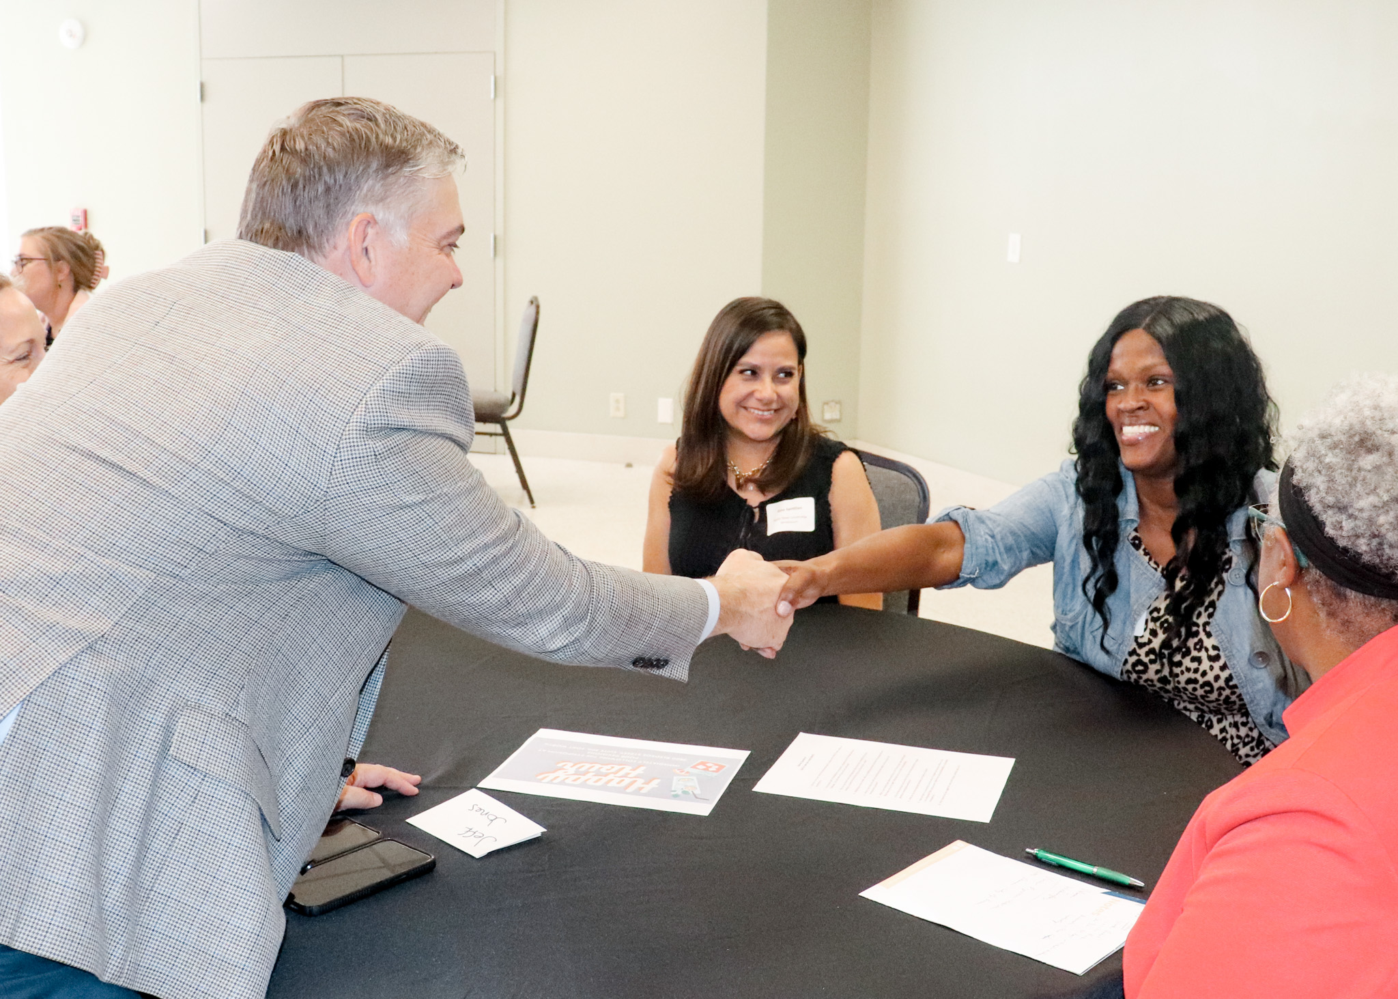
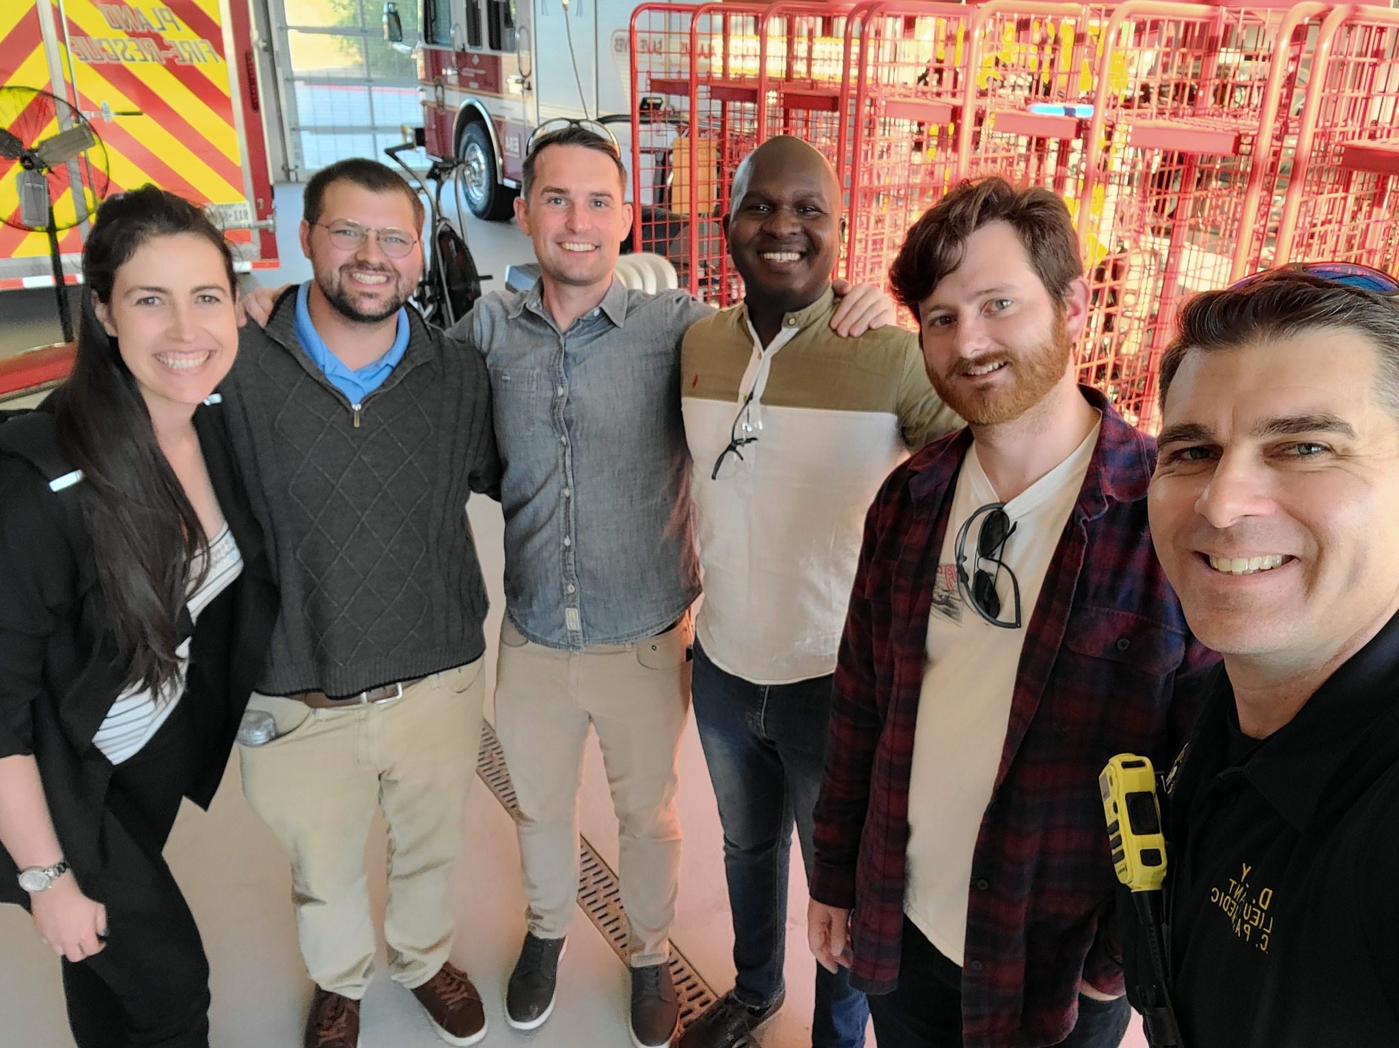
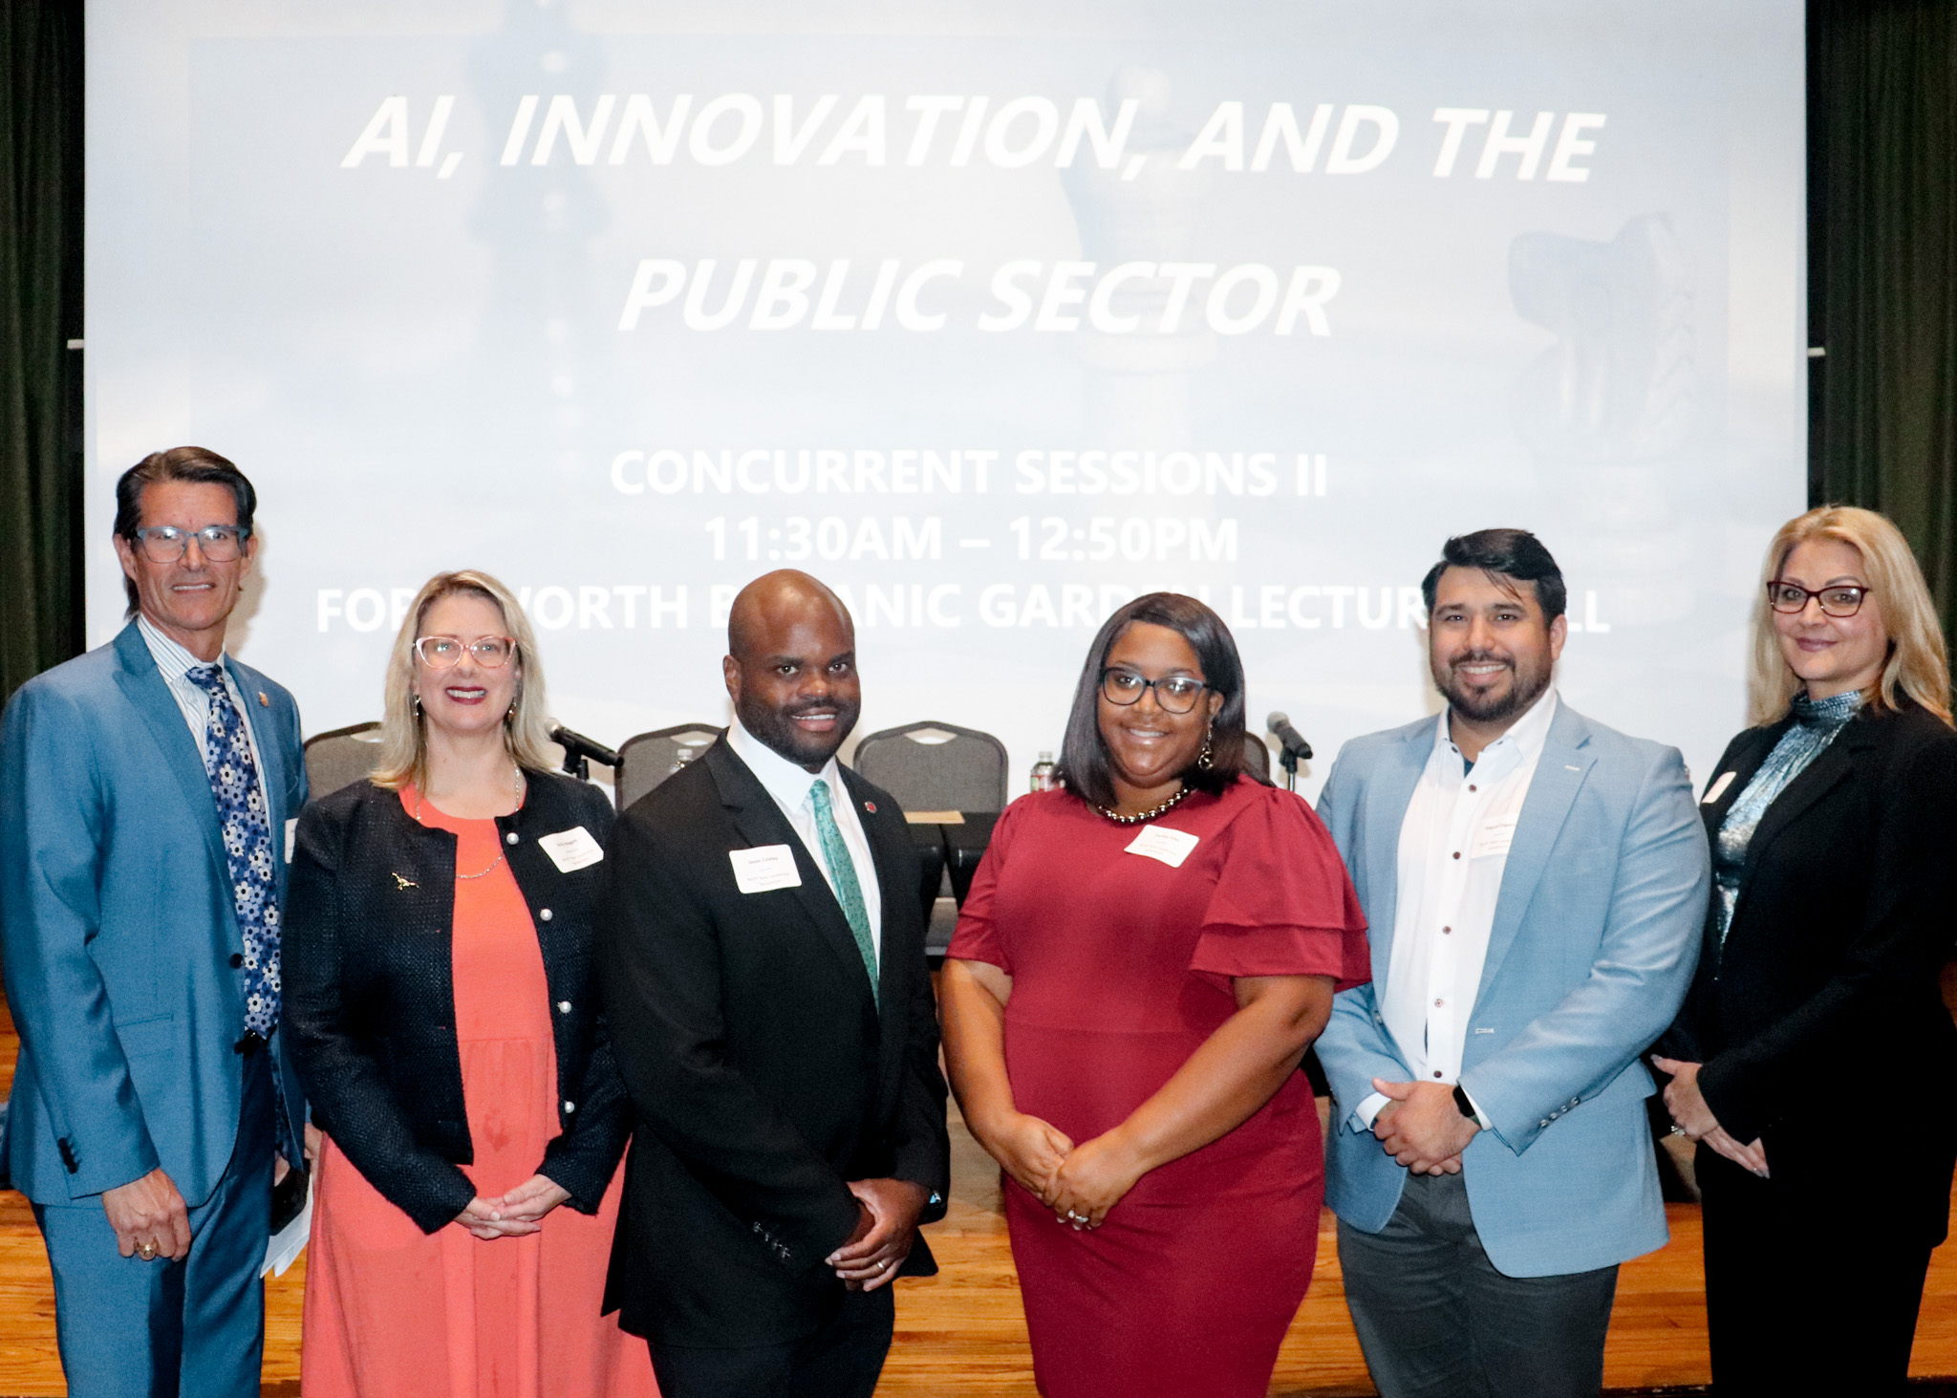
What is UMANT?
(2:20-2:30)
Urban Management Assistants of North Texas (UMANT) seeks to advance the quality of local government by providing a community to develop and support emerging leaders.

Slide 5
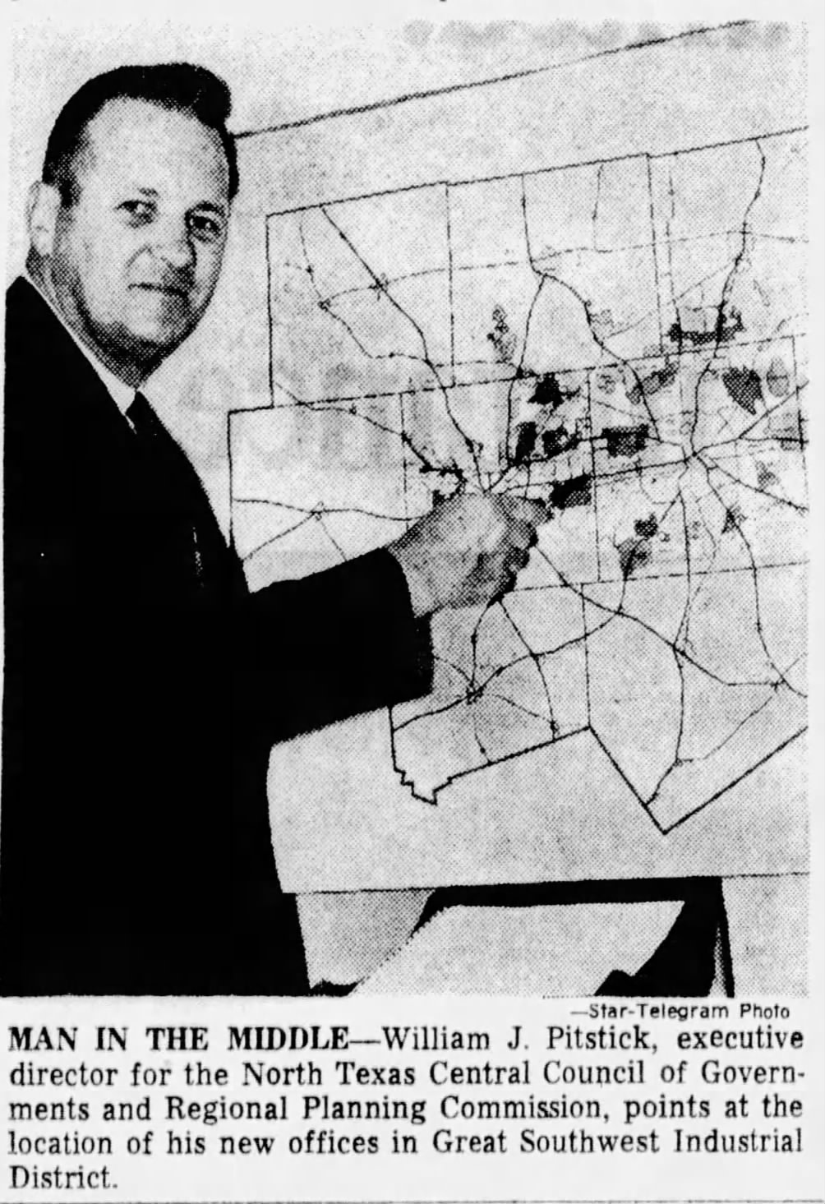
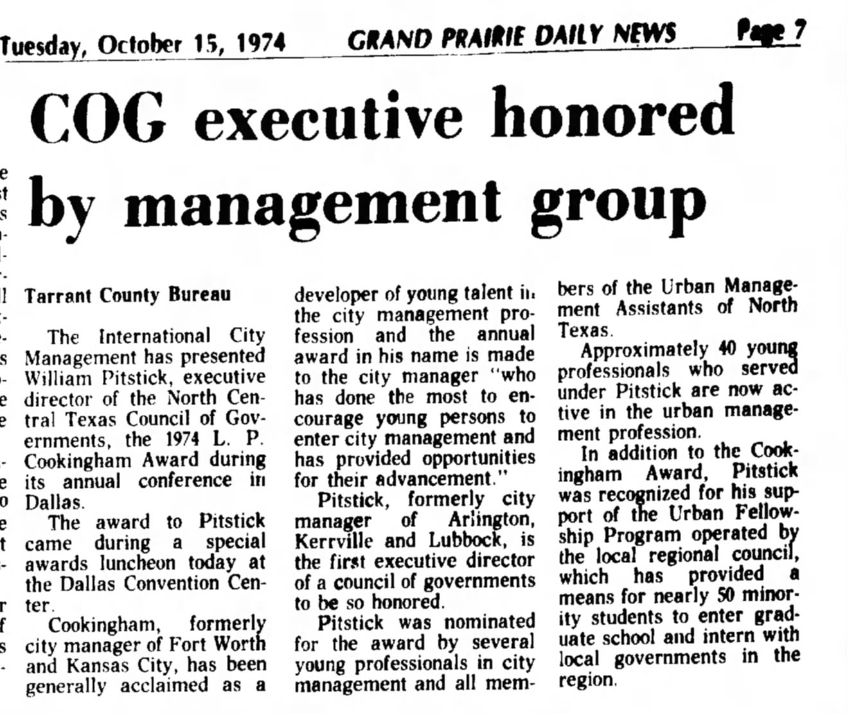
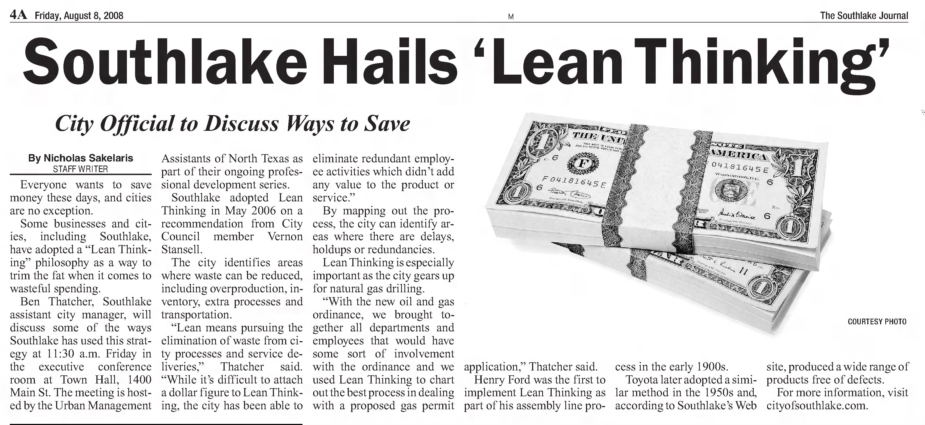
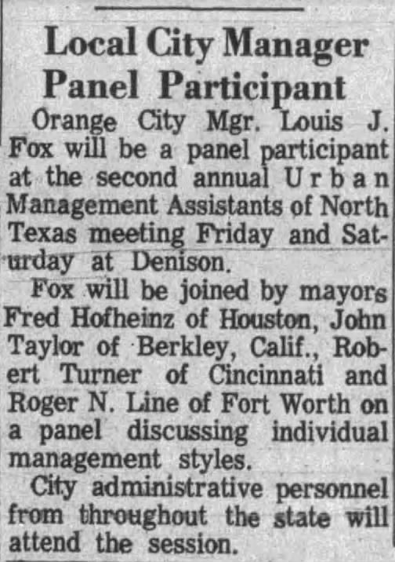
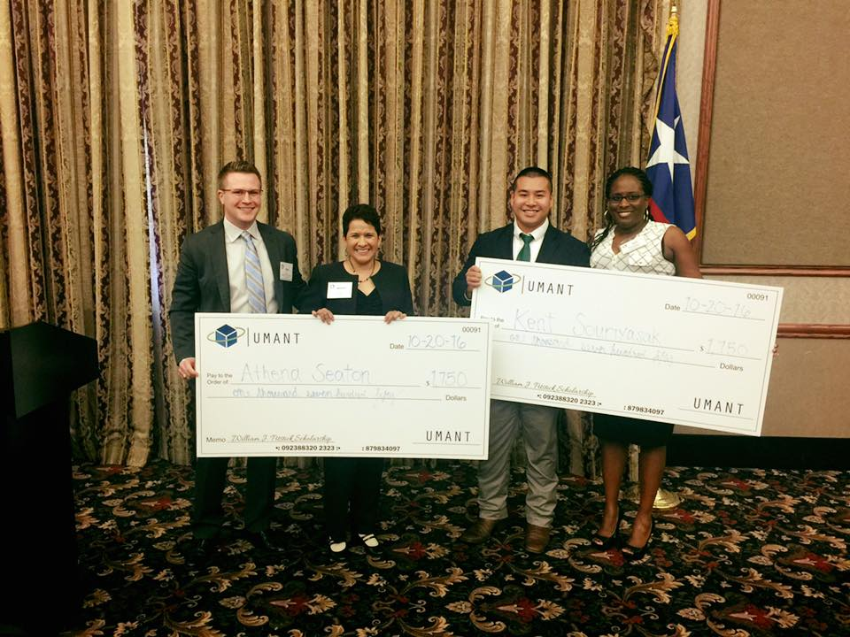
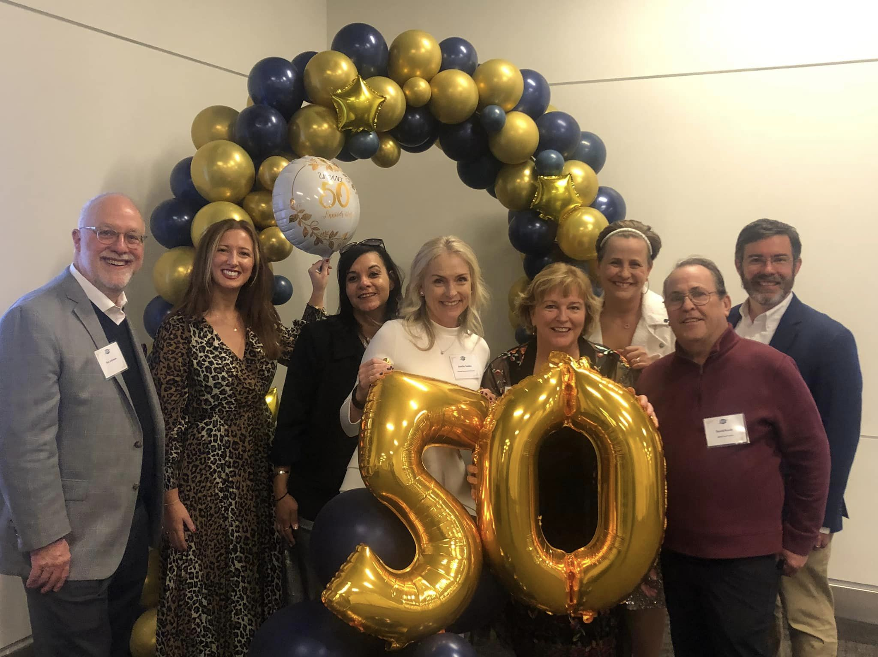
Disaster preparedness
Article about UMANT from the
December 4, 1994 page of the
Fort Worth Star Telegram
1980s
Mentorship
1990s
2000s
Professional
development
2010s
2020s
Networking
1970s
Management style
(2:20-2:30)
Scholarship

Slide 6
What is our value?
One Day Conference
Exec Connect
Wine and Dine
Happy Hours
Networking
Mentorship Program
William J. Pitstick
Scholarship
Lunch and Learn
Trends and Tours
Professional Development
Scholarship Opportunities
(2:20-2:30)

Slide 7
Mark McDaniel, SGR
Mark McDaniel has enjoyed an extensive background in local government, where he has served seven different communities ranging in population size from 8k to 1.3 million – including 22 years as a city manager, deputy city manager, or assistant city manager.
At SGR, Mark works with clients and candidates as an Executive Recruiter, utilizing extensive networks forged through his service as president of the Texas City Manager’s Association and Executive Vice President of the International City/County Management Association.
Mark is a strong advocate of the city management profession and is intent on providing mentoring and advice for the next generation of public administrators. He holds Bachelor and Master degrees from the University of North Texas (Go Mean Green!) and is a graduate of the Harvard University Senior Executives in State and Local Government Program.
Mark and his wife Cindy live in the DFW area to be close to their kids and grandkids. When Mark is not busy connecting with family or clients, you can find him in the outdoors or tending his garden.
(2:30-2:45)

Slide 8
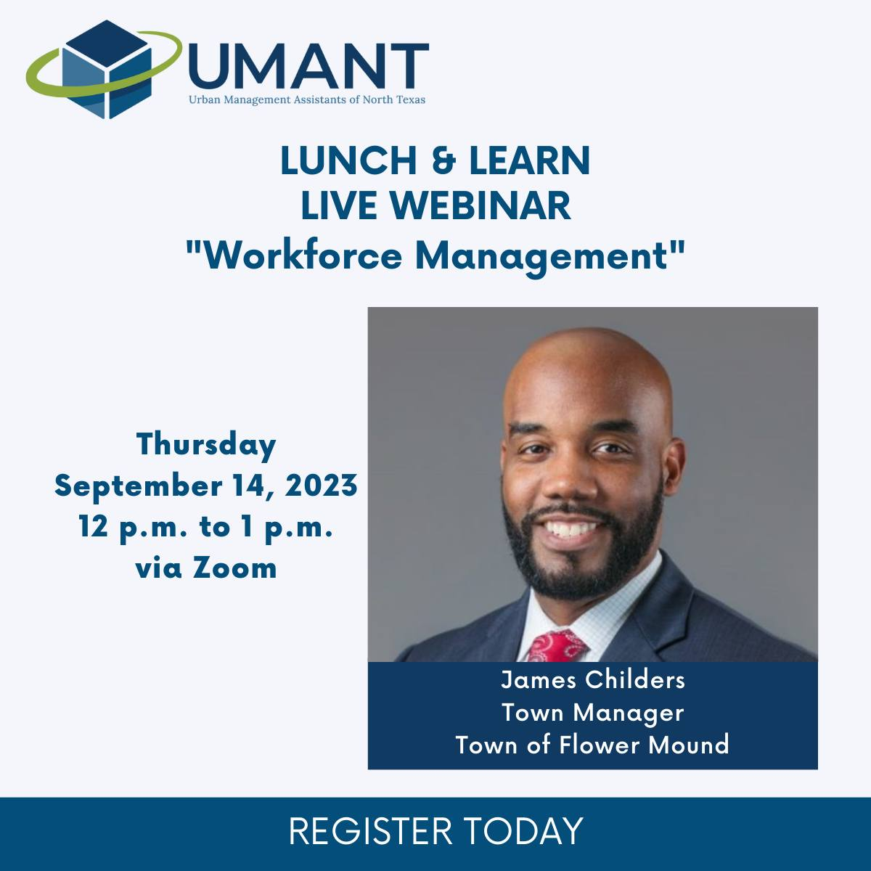
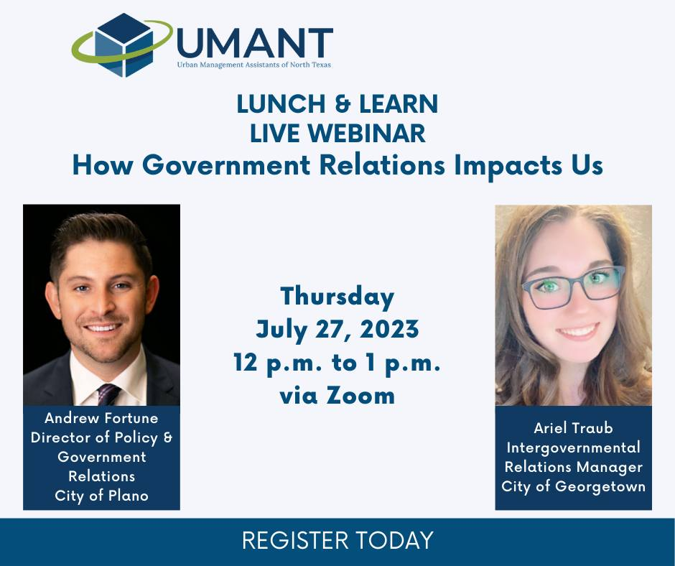
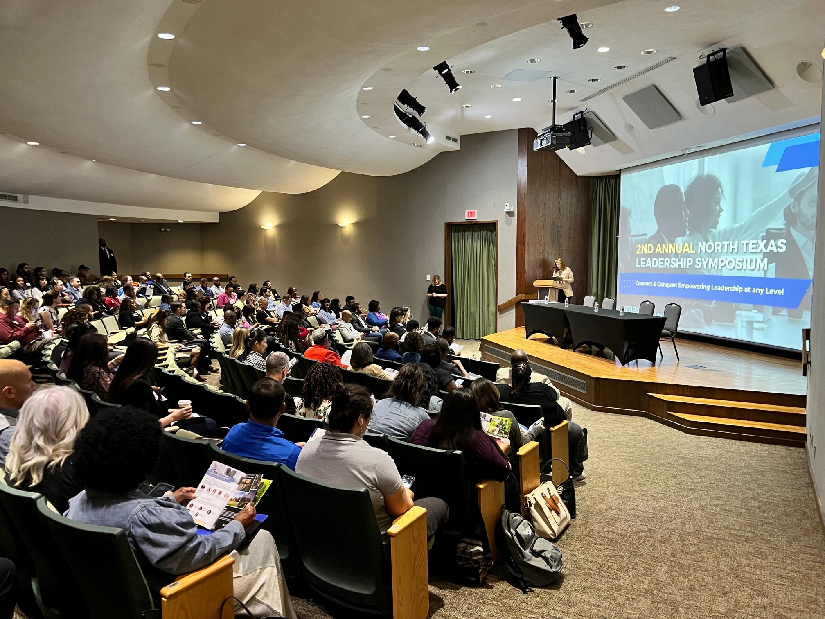
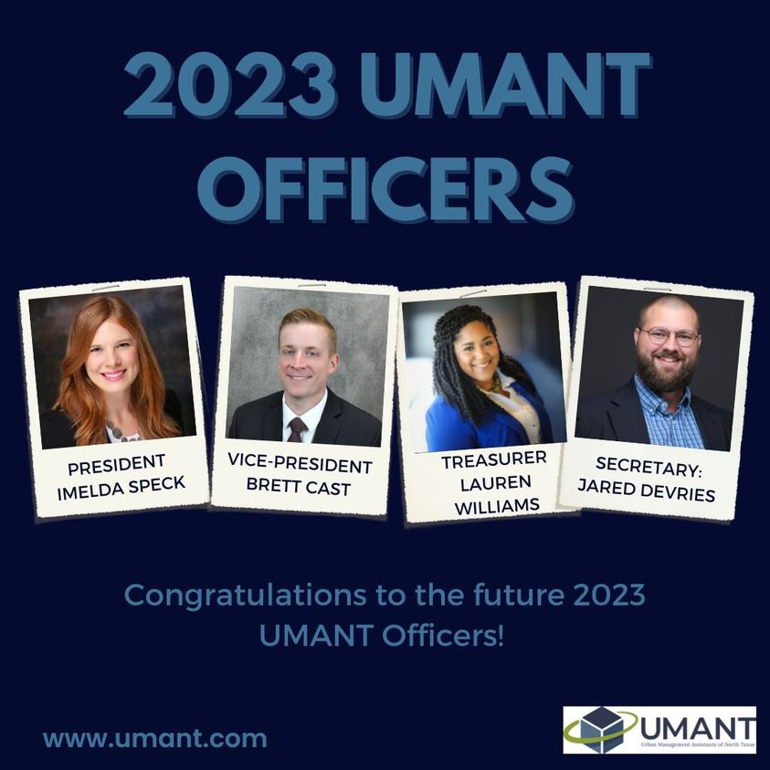
2023 UMANT Year in Review
(2:50-3:00)

Slide 9
2023 UMANT Year in Review
54 new members (all categories)
More than $8,000 raised for scholarship fund from ODC/2nd Annual NTLS
180 tickets sold to 2nd Annual North Texas Leadership Symposium
$7,000 distributed through the William Pitstick Scholarship Program
Three Lunch and Learns
Servant Leadership
How Government Relations Impacts Us
Workforce Development
One Trends and Tours event
Plano Fire-Rescue Training Center
438 page likes on Facebook
892 reactions on LinkedIn
Feedback
What was great?
What could be improved?
Streamlining Communications?
An additional Special Event?
Different kinds of Professional Development?
Building partnerships with municipalities?
How can we better communicate the value of UMANT in 2024?
(2:50-3:00)

Slide 10
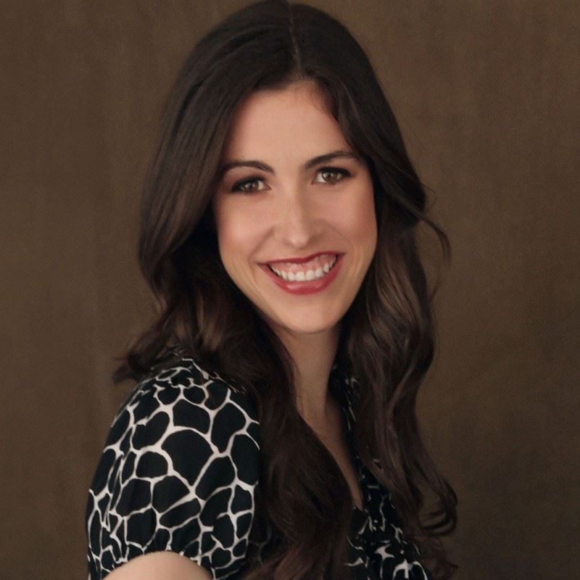
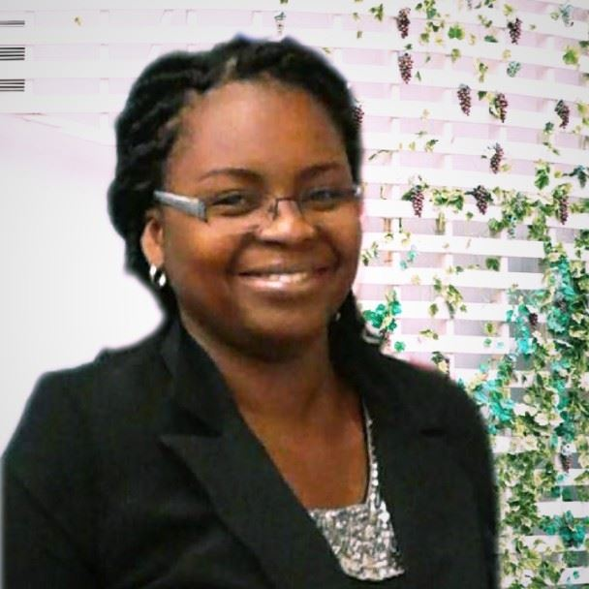
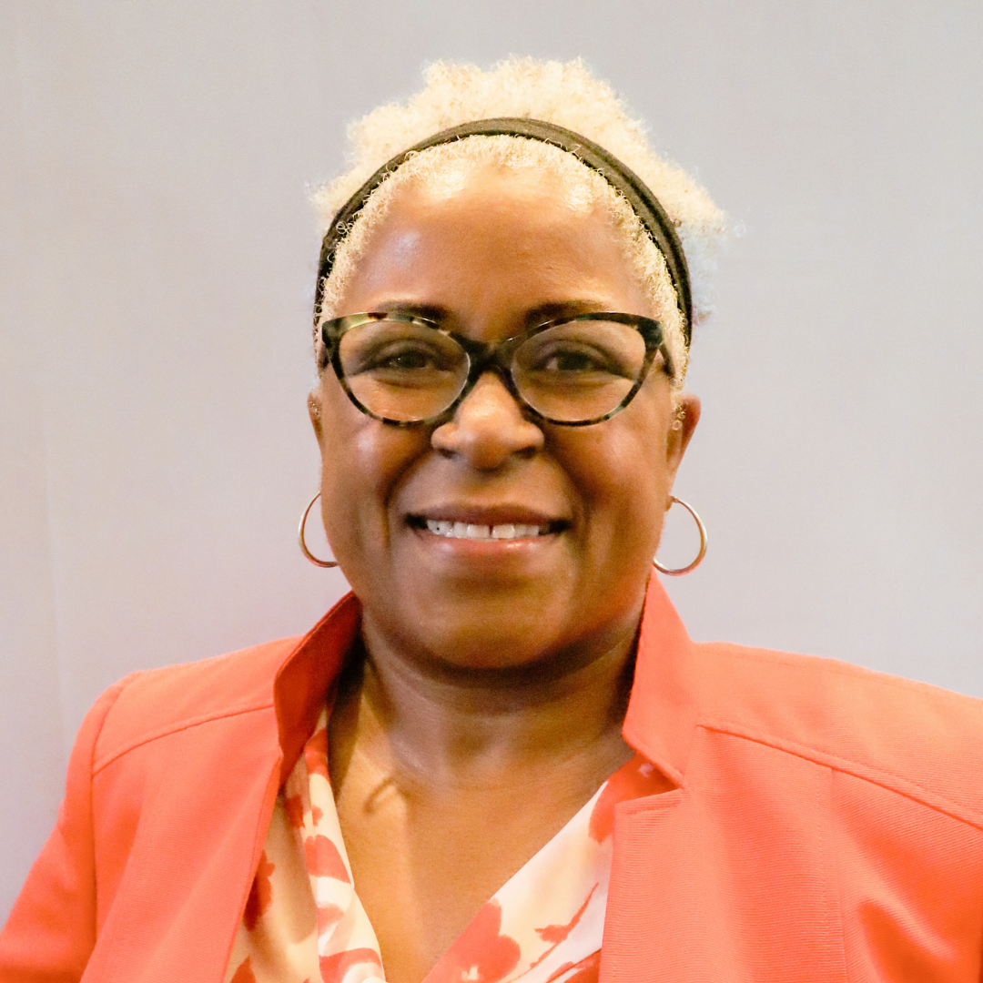
2024 UMANT Executive Committee
Officers:
President
Jared DeVries
Vice-President
Elizabeth Johnson
Treasurer
Aya Kouaho
Secretary
Maya Williams
Chairs:
(3:00-3:30)

Slide 11
Executive Committee Meetings
First Friday of each month via Zoom
Governed by 12th Ed. Of Robert’s Rules of Order
Attendance required for Officers and Chairs, but open to all members
Quorum for official business (approval of recommendations, resolutions, and procedural motions) shall be defined as 50% of the voting membership of the Executive Committee plus one.
6 members of the Executive Committee constitutes a quorum (Sec VII., Item c., d. UMANT Bylaws).
Approval of minutes from the prior meeting, updates from each of the Committees, general meeting items, acknowledgements, and future agenda item requests
(3:00-3:30)

Slide 12
Calendar Discussion
January
February
Kick-off HH (N+M)
March
Exec Connect and Happy Hour (N+M)
April
Lunch and Learn (PD)
May
Wine and Dine (SE)
June
July
Lunch and Learn (PD)
August
September
Lunch and Learn (PD)
October
ODC/2nd Annual NTLS (SE)
Trends and Tours (PD)
November
December
End of Year Brunch (N+M)
N+M: Networking and Mentorship
PD: Professional Development
SE: Special Events
(3:30-3:50)

Slide 13
2024 Dates of Note
January
Su | Mo | Tu | We | Th | Fr | Sa
 | 1 | 2 | 3 | 4 | 5 | 6
7 | 8 | 9 | 10 | 11 | 12 | 13
14 | 15 | 16 | 17 | 18 | 19 | 20
21 | 22 | 23 | 24 | 25 | 26 | 27
28 | 29 | 30 | 31
February
Su | Mo | Tu | We | Th | Fr | Sa
 |  |  |  | 1 | 2 | 3
4 | 5 | 6 | 7 | 8 | 9 | 10
11 | 12 | 13 | 14 | 15 | 16 | 17
18 | 19 | 20 | 21 | 22 | 23 | 24
25 | 26 | 27 | 28 | 29
March
Su | Mo | Tu | We | Th | Fr | Sa
 |  |  |  |  | 1 | 2
3 | 4 | 5 | 6 | 7 | 8 | 9
10 | 11 | 12 | 13 | 14 | 15 | 16
17 | 18 | 19 | 20 | 21 | 22 | 23
24 | 25 | 26 | 27 | 28 | 29 | 30
31
April
Su | Mo | Tu | We | Th | Fr | Sa
 | 1 | 2 | 3 | 4 | 5 | 6
7 | 8 | 9 | 10 | 11 | 12 | 13
14 | 15 | 16 | 17 | 18 | 19 | 20
21 | 22 | 23 | 24 | 25 | 26 | 27
28 | 29 | 30
UMANT Exec Committee Meetings
William “King” Cole Session 1 (Austin)
Jan 25-26
William “King” Cole Session 2 (San Antonio)
April 4-5
GFOAT Spring Conference (Round Rock)
April 4-6
TCMA Conference (South Padre Island)
June 20-23
ICMA Conference (Pittsburgh, PA)
Sept 21-25
TML Annual Conference (Houston)
Oct 9-11
GFOAT Fall Conference (San Marcos)
Oct 30-Nov 1
TML Economic Development (Bastrop)
Nov 14-15
May
Su | Mo | Tu | We | Th | Fr | Sa
 |  |  | 1 | 2 | 3 | 4
5 | 6 | 7 | 8 | 9 | 10 | 11
12 | 13 | 14 | 15 | 16 | 17 | 18
19 | 20 | 21 | 22 | 23 | 24 | 25
26 | 27 | 28 | 29 | 30 | 31
June
Su | Mo | Tu | We | Th | Fr | Sa
 |  |  |  |  |  | 1
2 | 3 | 4 | 5 | 6 | 7 | 8
9 | 10 | 11 | 12 | 13 | 14 | 15
16 | 17 | 18 | 19 | 20 | 21 | 22
23 | 24 | 25 | 26 | 27 | 28 | 29
30
July
Su | Mo | Tu | We | Th | Fr | Sa
 | 1 | 2 | 3 | 4 | 5 | 6
7 | 8 | 9 | 10 | 11 | 12 | 13
14 | 15 | 16 | 17 | 18 | 19 | 20
21 | 22 | 23 | 24 | 25 | 26 | 27
28 | 29 | 30 | 31
August
Su | Mo | Tu | We | Th | Fr | Sa
 |  |  |  | 1 | 2 | 3
4 | 5 | 6 | 7 | 8 | 9 | 10
11 | 12 | 13 | 14 | 15 | 16 | 17
18 | 19 | 20 | 21 | 22 | 23 | 24
25 | 26 | 27 | 28 | 29 | 30 | 31
September
Su | Mo | Tu | We | Th | Fr | Sa
1 | 2 | 3 | 4 | 5 | 6 | 7
8 | 9 | 10 | 11 | 12 | 13 | 14
15 | 16 | 17 | 18 | 19 | 20 | 21
22 | 23 | 24 | 25 | 26 | 27 | 28
29 | 30
October
Su | Mo | Tu | We | Th | Fr | Sa
 |  | 1 | 2 | 3 | 4 | 5
6 | 7 | 8 | 9 | 10 | 11 | 12
13 | 14 | 15 | 16 | 17 | 18 | 19
20 | 21 | 22 | 23 | 24 | 25 | 26
27 | 28 | 29 | 30 | 31
November
Su | Mo | Tu | We | Th | Fr | Sa
 |  |  |  |  | 1 | 2
3 | 4 | 5 | 6 | 7 | 8 | 9
10 | 11 | 12 | 13 | 14 | 15 | 16
17 | 18 | 19 | 20 | 21 | 22 | 23
24 | 25 | 26 | 27 | 28 | 29 | 30
December
Su | Mo | Tu | We | Th | Fr | Sa
1 | 2 | 3 | 4 | 5 | 6 | 7
8 | 9 | 10 | 11 | 12 | 13 | 14
15 | 16 | 17 | 18 | 19 | 20 | 21
22 | 23 | 24 | 25 | 26 | 27 | 28
29 | 30 | 31
(3:30-3:50)

Slide 14
Other Items and Initiatives
Immediate Past-President By-law Amendment
Financial Policy
Executive Board will continue to work on formalizing financial processes and procedures
Awaiting review of last year’s financial comprehensive report
Municipal Partnership Initiative (MPI)
(4:20-5:00)

Slide 15
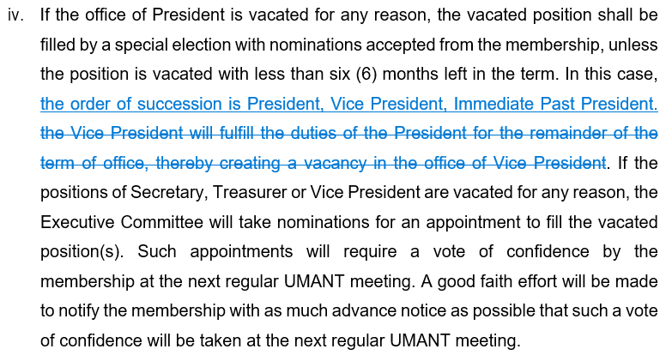
Immediate Past-President By-law Amendment
Context: Last year, the role of Immediate Past-President (IPP) was highlighted due to President being on work leave due to baby and VP moving out of DFW area. One-year presidential term makes organization prone to institutional weakness.
Purpose: To better strengthen UMANT during transitions and clarify succession process. IPP would assist with continuity between outgoing and incoming Officers and provide support for organization programming and events.
Changes: Add Immediate Past-President as a member of the Executive Board with voting privileges. Add Immediate Past President into succession order.
Next steps: Present revisions to full membership to receive input. Present revisions to Executive Committee. Amendment must then be approved by 2/3rds of present and voting members of the Executive Committee (7) to be placed on a ballot.
Ballot with amendment is then distributed to membership (via website) and voting is open for 30 days.
Acceptance or rejection of amendment is determined by a simple majority of votes of the entire membership* (65 votes necessary for passage).
*Membership does not include lapsed members or overdue renewals
(Section IV., Item b., subsection i. Dues shall be paid annually.)
(4:20-5:00)

Slide 16
Financial Policy
Executive Board will continue to work on formalizing financial processes and procedures
Awaiting review of last year’s financial comprehensive report

Slide 17
Municipal Partnership Initiative (MPI)
This year, the Executive Board will make it a priority to connect with municipalities
Connecting local government professionals already working to join UMANT
New members highlighting needs in skills and professional development for career advancement

Slide 18
Questions?
(4:20-5:00)

